Slide 1
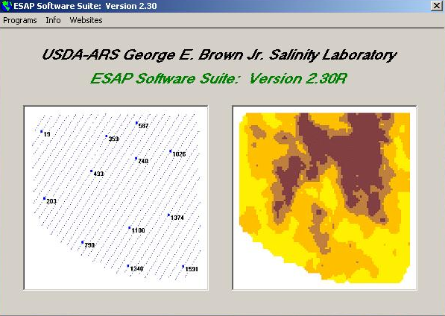
ESAP Signal Processing Software

Slide 2
Objectives
Edit EC_{a} survey data using the EC_{e} Sampling Assessment and Prediction (ESAP).
Create a sampling design using ESAP.
Create a salinity map using the ESAP SaltMapper software.

Slide 3
ESAP
EC_{e} (or Salinity) Sampling, Assessment, and Prediction
A statistical software package for estimating field-scale, spatial soil property patterns from EMI signal data.
Developed at the USDA-ARS US Salinity Laboratory in Riverside, CA and specifically designed to facilitate cost-effective, technically sound, soil salinity assessment and data interpretation techniques.
Available for download free of charge online at: https://www.ars.usda.gov/pacific-west-area/riverside-ca/us-salinity-laboratory/docs/esap-model/

Slide 4
Core Modules in ESAP
ESAP-RSSD (Response Surface Sampling Design)
Examine, analyze, & summarize EC_{a} survey data
Generates optimal soil sampling designs from sensor data
ESAP-Calibrate
Converts survey data into predicted soil salinity (a/o other soil properties)
Diagnose & identify primary soil properties influencing survey data
Generates multiple field summary statistics
Generates prediction data (used for making spatial maps)
ESAP-SaltMapper
1-D transect plots and 2-D raster maps
Tile line maps, calculate tile line locations, diagnose potential tile line problems

Slide 5
Support Modules in ESAP
ESAP-SigDPA (Signal Data Pre-processing Algorithm)
Tool to pre-process signal data into format used and recognized by core Modules.
Perform signal data QA/QC and validity checks, scale conversion, and row (transect) identification & assignment.
ESAP-DPPC (Dual Parallel Pathway Conductance) Calculator
Convenient to use calculator version of the 1989 Rhoades DPPC model
Used for direct prediction of salinity from spot 4-probe or EM survey data given soil temperature, texture, and moisture measurements (or estimates)

Slide 6
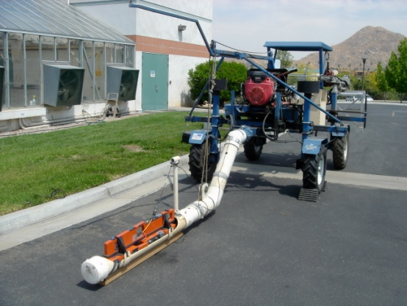
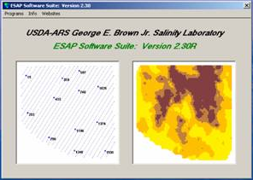

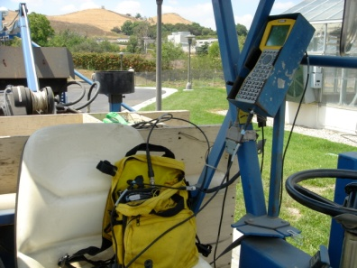
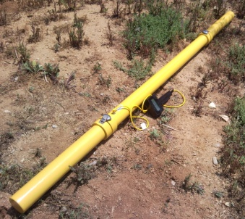
Salinity Assessment
3 Components
1. Vehicle
(Spider SprayTrac)
2. Electrical Conductivity Sensor
EM Sensor
(Geonics EM-38DD
(Dual Dipole) / Dualem DualEM-2)
3. Signal Processing Software
(ESAP)
GPS System
(Trimble Pathfinder)

Slide 7
Editing EM Data and Creating Sample Designs in ESAP

Slide 8
Before Opening ESAP
Download EM survey file from datalogger and view in Trimble Pathfinder.
Export survey file (Pathfinder will create a file called “Sensor.txt”).
The “Sensor.txt” file will be the file that you import into ESAP.

Slide 9
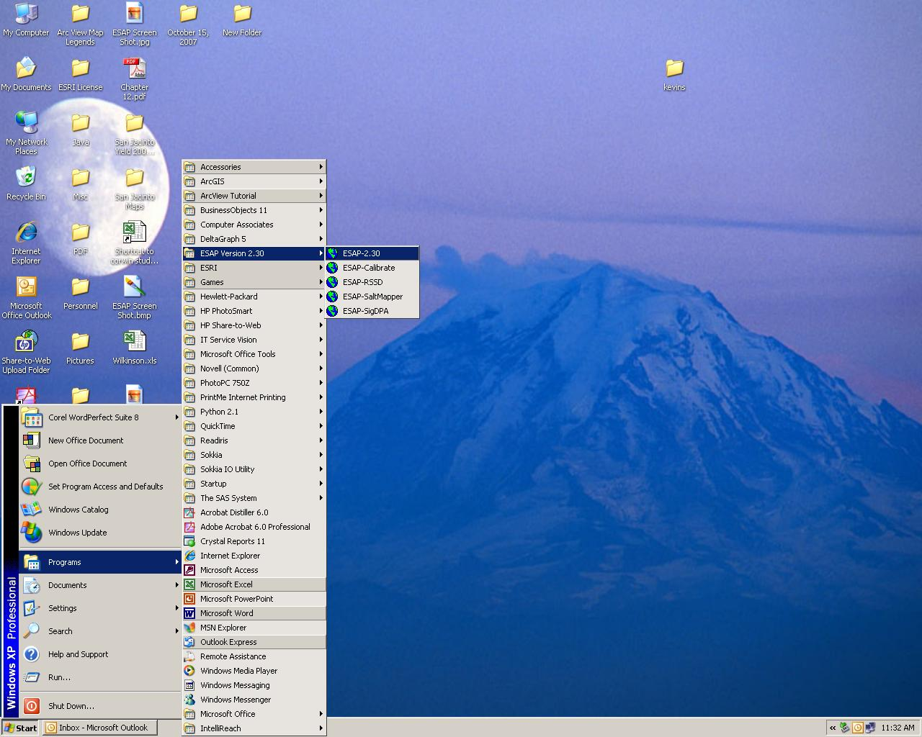
Editing EM Data in ESAP
Select ESAP from the “Programs” menu.

Slide 10
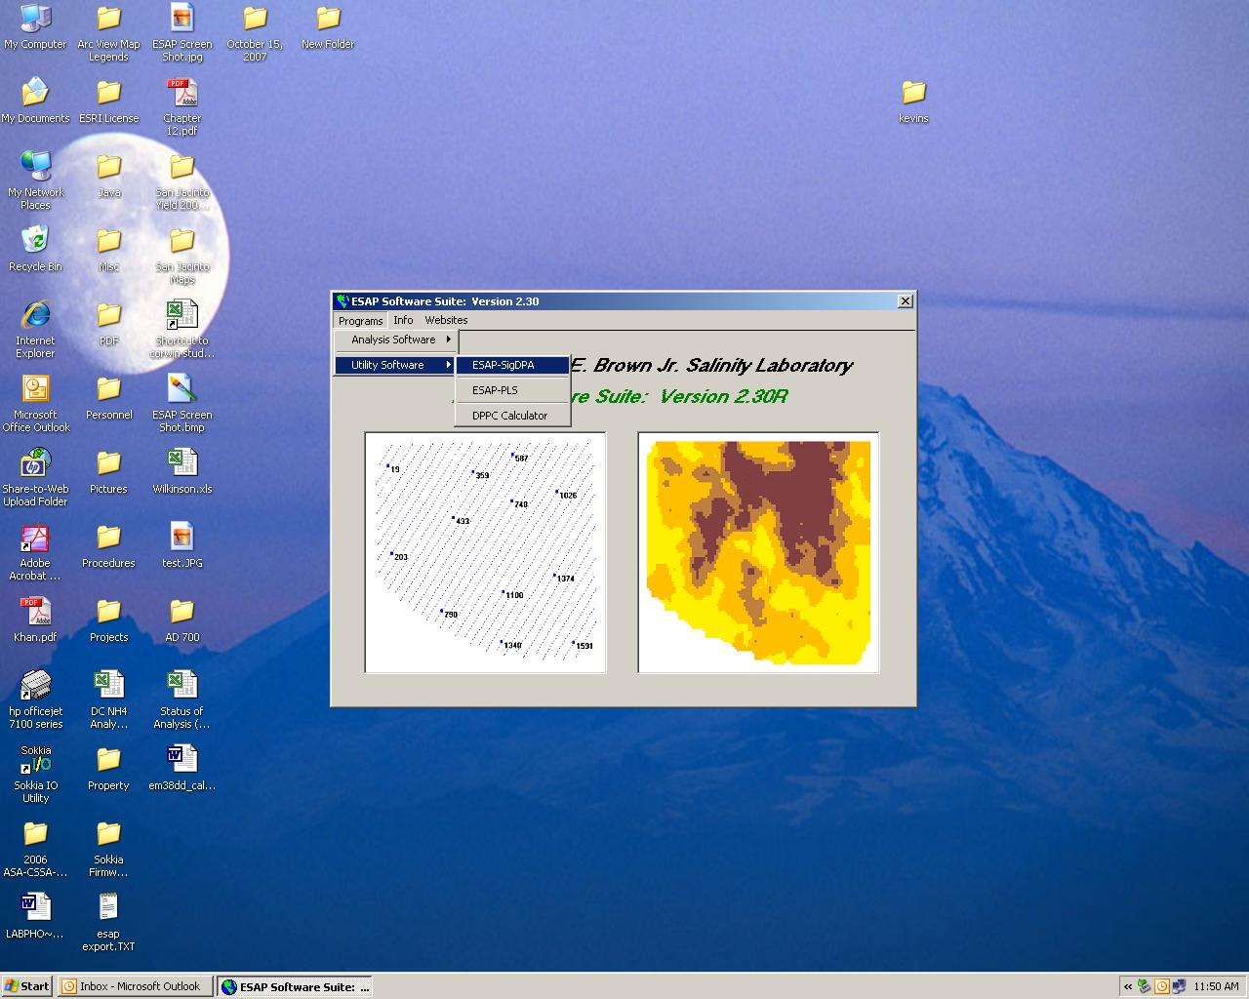
Editing EM Data in ESAP
Select ESAP Sig-DPA under “Programs” and “Utility Software” menus.

Slide 11
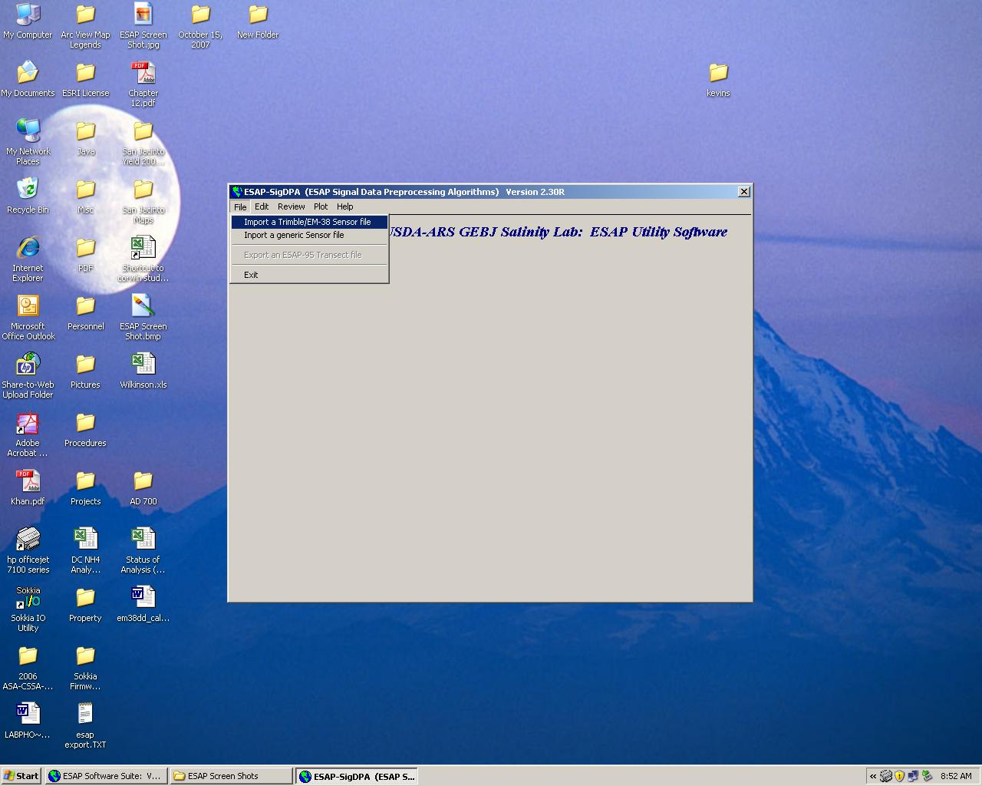
Editing EM Data in ESAP
Select Import a Trimble/EM-38 Sensor file under the “File” menu.

Slide 12
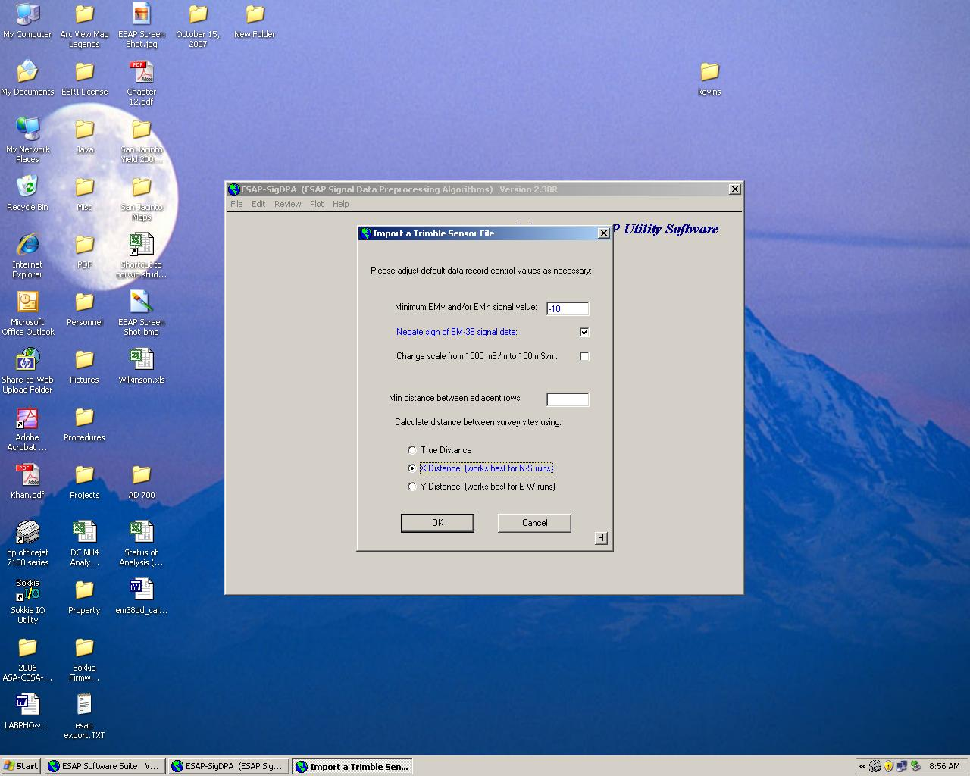
Editing EM Data in ESAP
Select file and click on “Import Data” button. Select desired features and click “OK.”

Slide 13
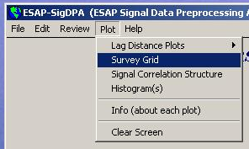
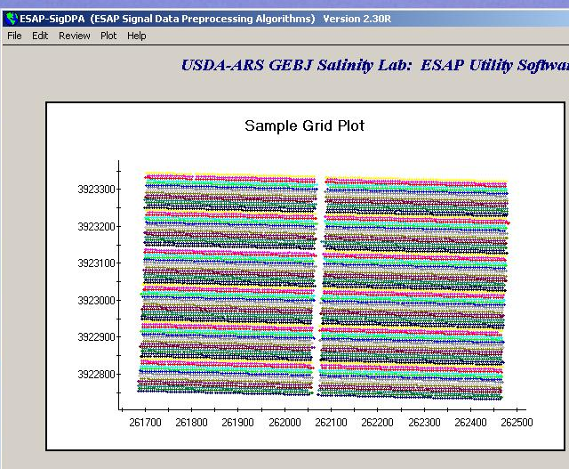
Editing EM Data in ESAP
Select Survey Grid under “Plot” menu to view your survey rows.

Slide 14
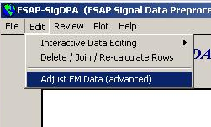
Editing EM Data in ESAP
Select Adjust EM Data under “Edit” menu

Slide 15
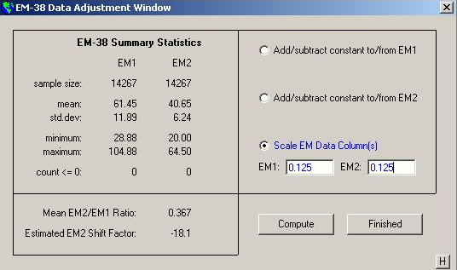
Editing EM Data in ESAP
Scale EM data to 0.125 its current value.

Slide 16
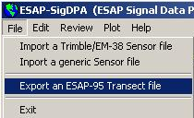
Editing EM Data in ESAP
Select Export an ESAP-95 Transect file under the “File” menu.

Slide 17
Editing EM Data in ESAP
Exit by clicking Exit under the “File” menu. You are now ready to create a sampling design.

Slide 18

Creating a Sampling Design in ESAP
Select ESAP-RSSD under the “Programs” and “Analysis Software” menus.

Slide 19
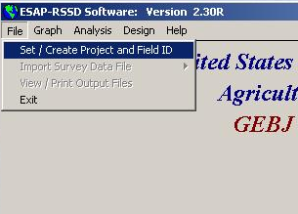
Creating a Sampling Design in ESAP
Select Set/Create Project and Field ID under “File” menu.

Slide 20

Creating a Sampling Design in ESAP
Create Project in “Create/Set Project” window.

Slide 21
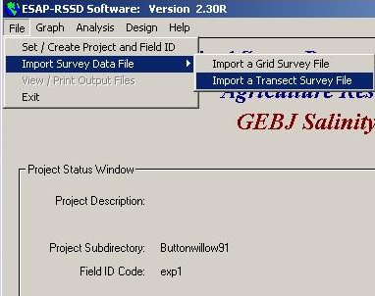
Creating a Sampling Design in ESAP
Select Import a Transect Survey File under the “File” and “Import Survey Data File.”

Slide 22
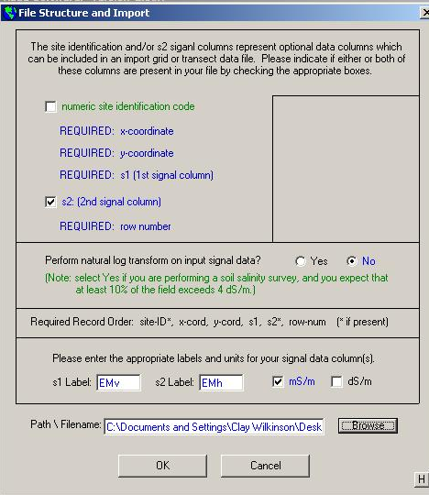
Creating a Sampling Design in ESAP
Browse to locate file, click on it, then click “OK” in the “File Structure and Import” window.

Slide 23
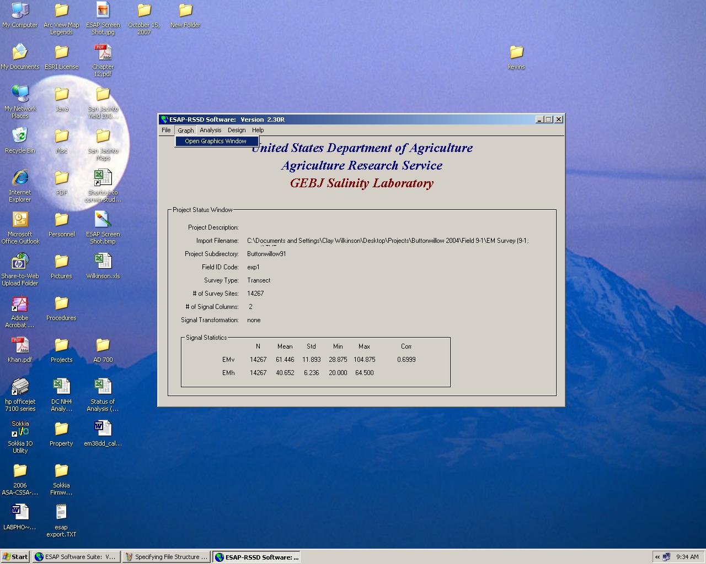
Creating a Sampling Design in ESAP
Select Open Graphics Window under “Graph” menu.

Slide 24
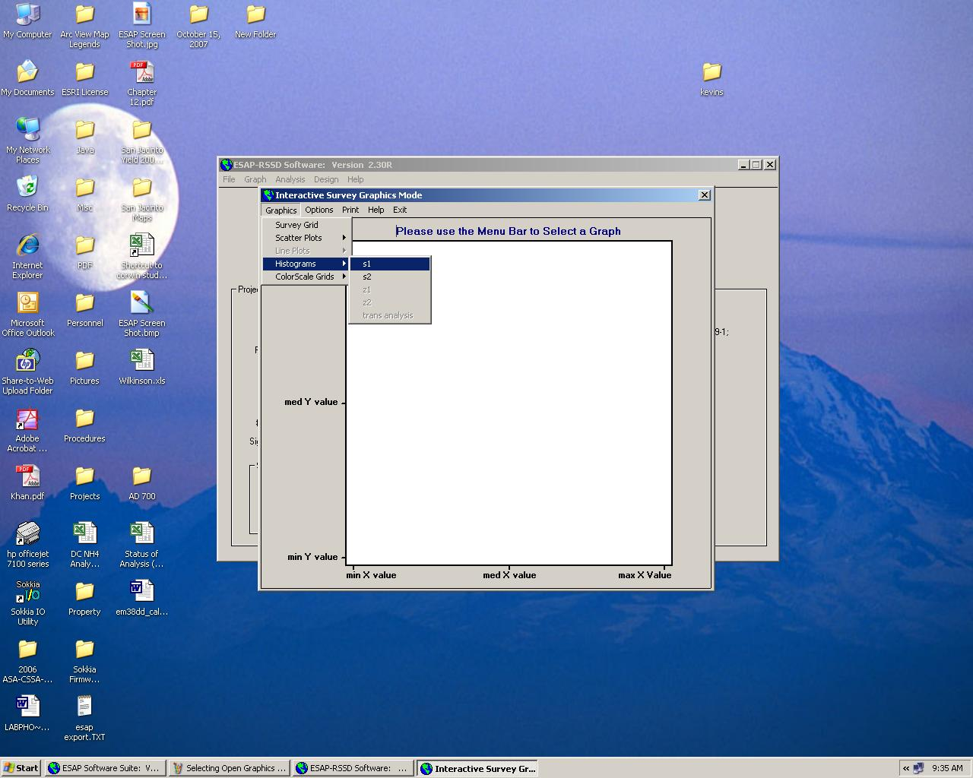
Creating a Sampling Design in ESAP
Select s1 under “Graphics” and “Histograms” menus. You can now view a histogram of the EM_{v} values.

Slide 25
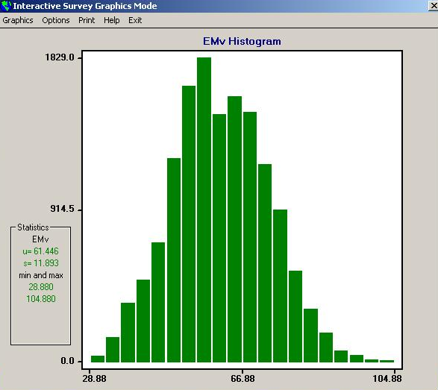
Creating a Sampling Design in ESAP
View histogram for EM_{v} values.

Slide 26

Creating a Sampling Design in ESAP
Select Signal Decorrelation under the “Analysis” menu.

Slide 27
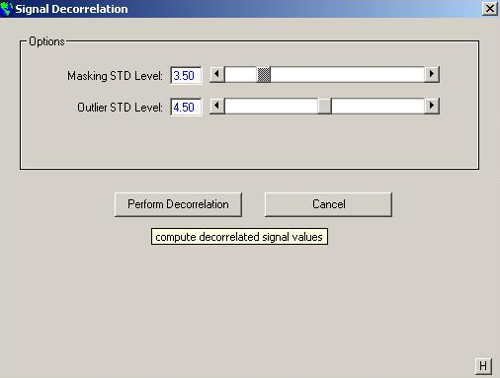
Creating a Sampling Design in ESAP
Click “Perform Decorrelation” button.

Slide 28
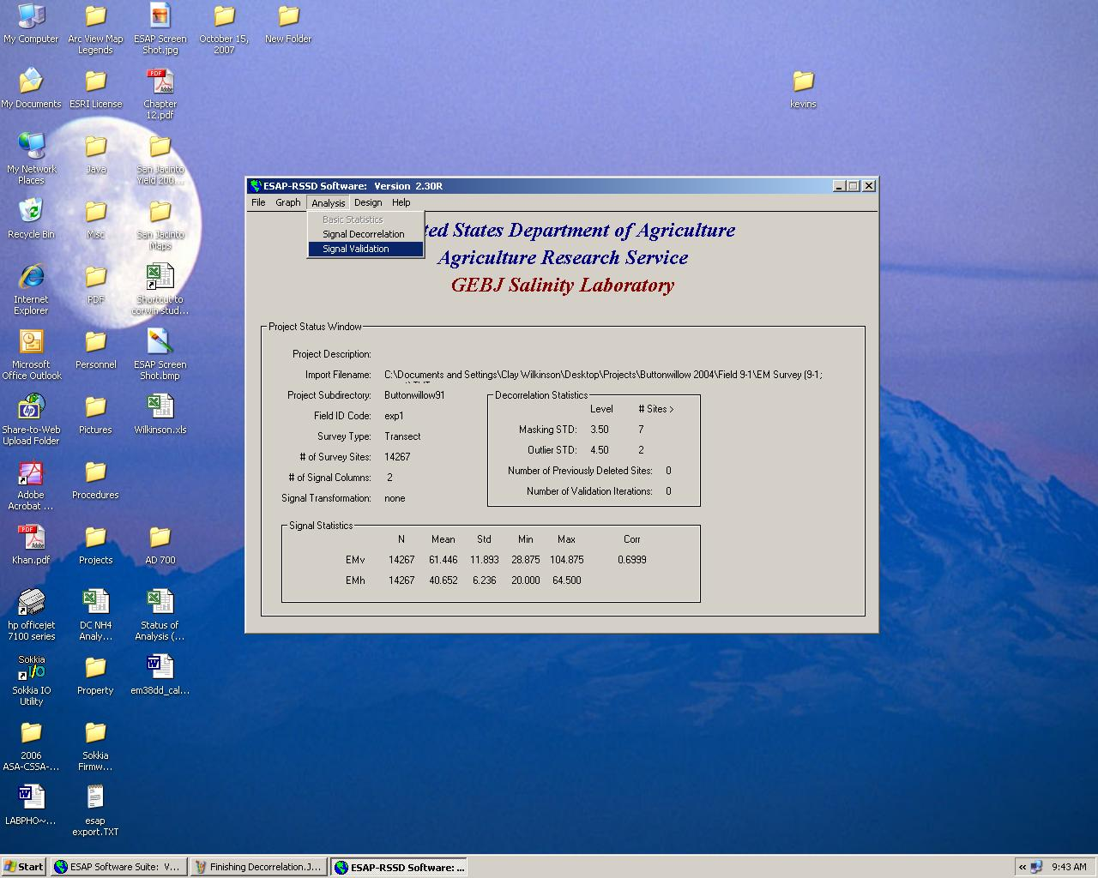
Creating a Sampling Design in ESAP
Select Signal Validation from the “Analysis.”

Slide 29

Creating a Sampling Design in ESAP
Invoke signal validation.

Slide 30

Creating a Sampling Design in ESAP
Select Calculate SRS Sample Design under the “Design” menu.

Slide 31
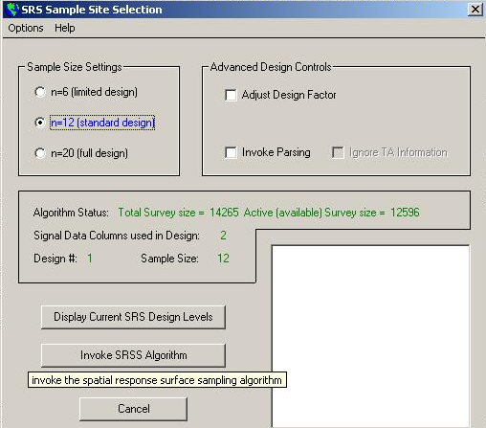
Creating a Sampling Design in ESAP
Invoke SRS Algorithm.

Slide 32
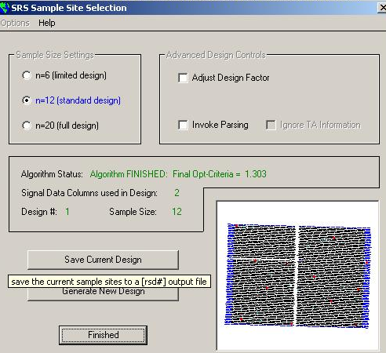
Creating a Sampling Design in ESAP
Save Current Design.

Slide 33
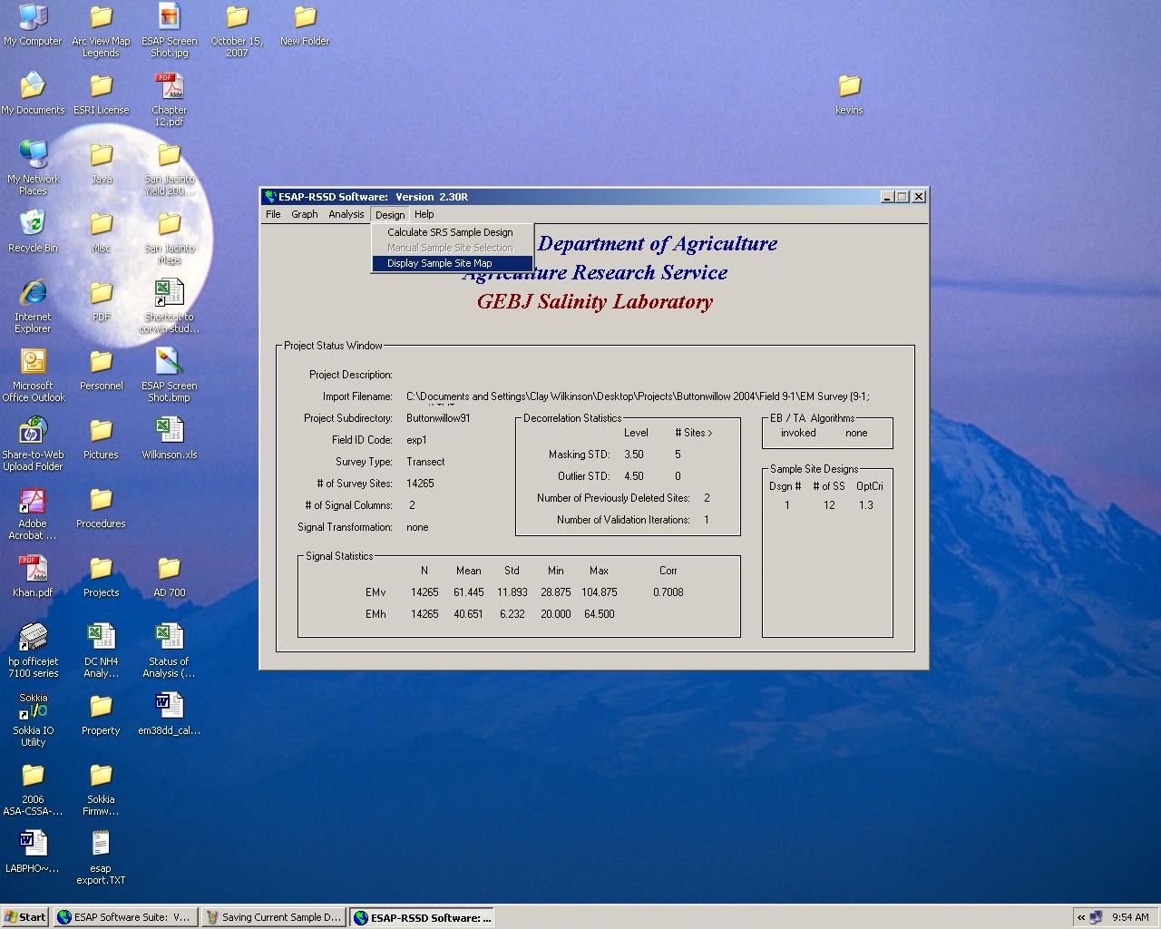
Creating a Sampling Design in ESAP
Select Display Sample Site Map under the “Design” menu.

Slide 34
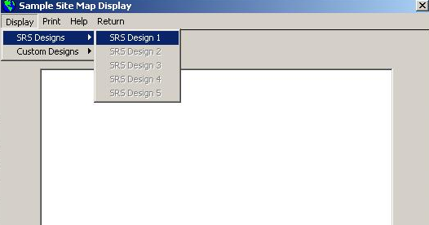
Creating a Sampling Design in ESAP
Select desired SRS Design under the “Display” and “SRS Designs” menus.

Slide 35
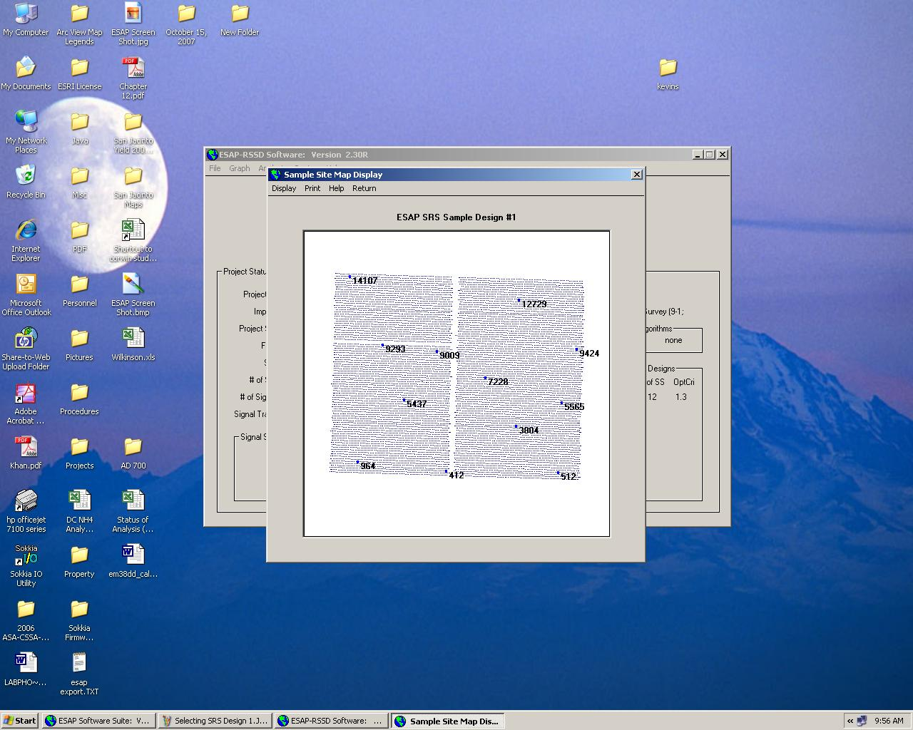
Creating a Sampling Design in ESAP
You can now view, print, and save your sampling design map.

Slide 36

Creating a Salinity Map in ESAP
Select ESAP-SaltMapper from the “Programs” and “Analysis Software” menus.

Slide 37

Creating a Salinity Map in ESAP
Select Specify/Input File Info from the “File” menu.

Slide 38
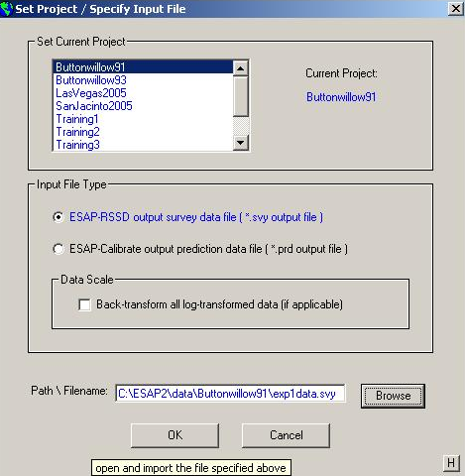
Creating a Salinity Map in ESAP
Specify Current Project, Input File Type, and Path/Filename.

Slide 39
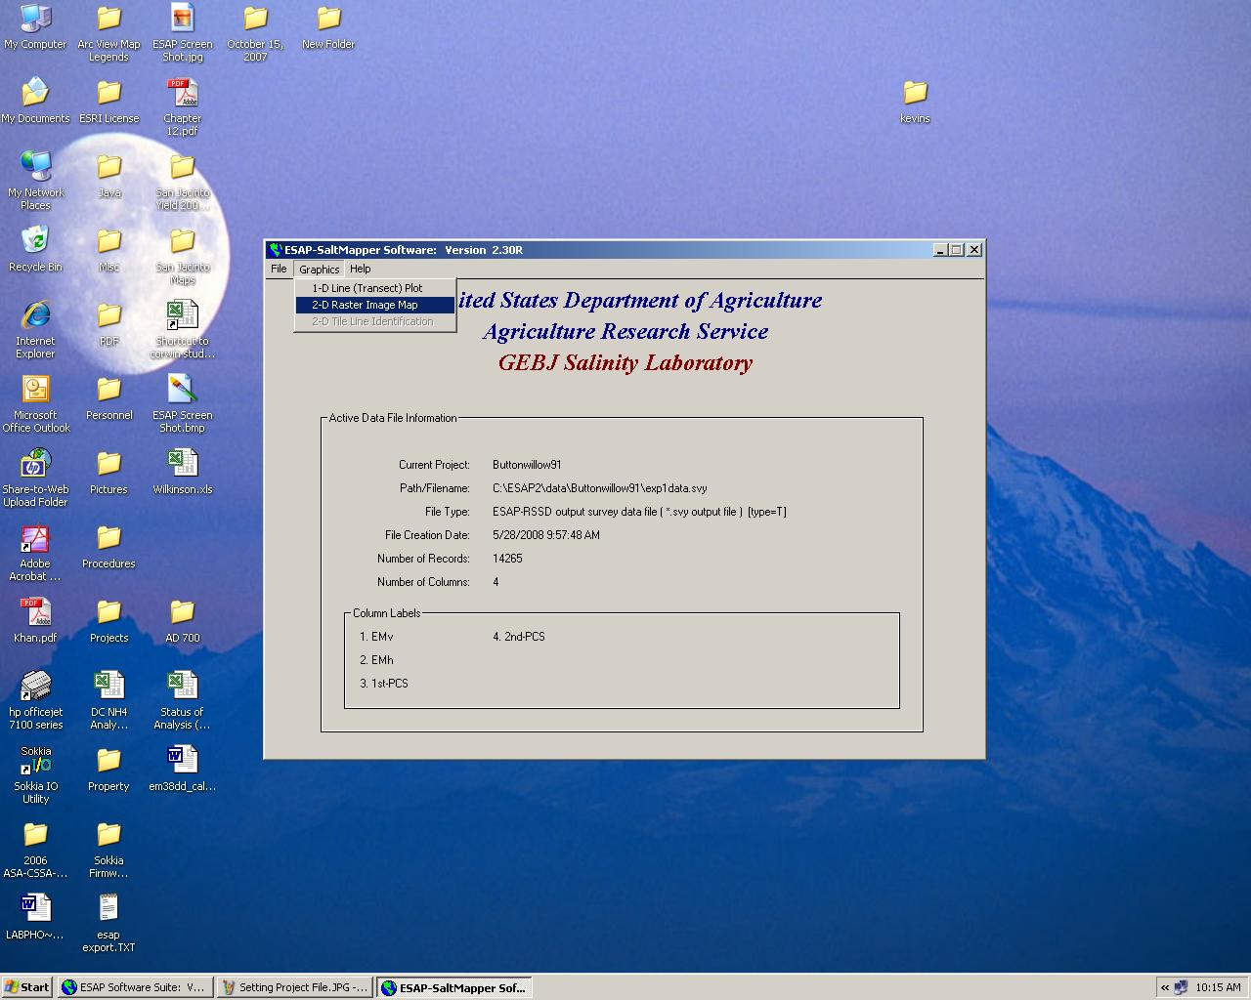
Creating a Salinity Map in ESAP
Select 2-D Raster Image Map from “Graphics” menu.

Slide 40
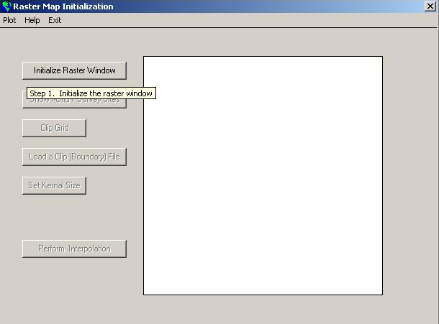
Creating a Salinity Map in ESAP
Initialize Raster Window.

Slide 41
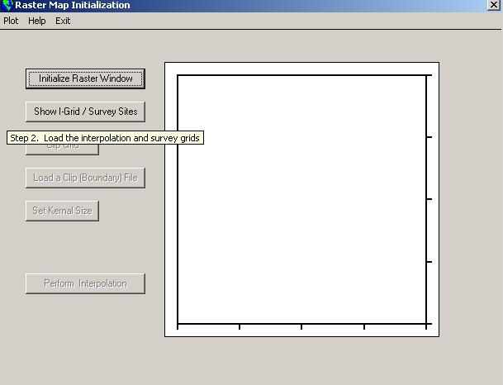
Creating a Salinity Map in ESAP
Click “Show I-Grid/Survey Sites” button.

Slide 42
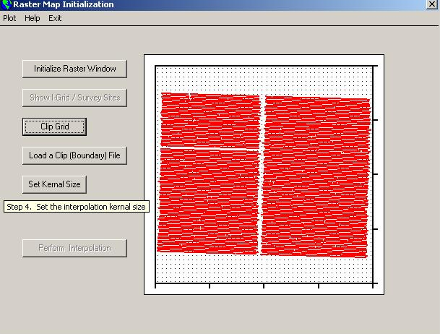
Creating a Salinity Map in ESAP
Click “Set Kernel Size.”

Slide 43

Creating a Salinity Map in ESAP
Click “Perform Interpolation.”

Slide 44
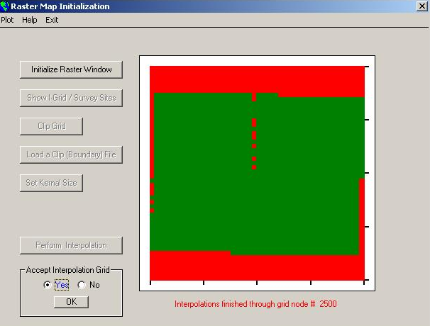
Creating a Salinity Map in ESAP
Accept Interpolation Grid.

Slide 45
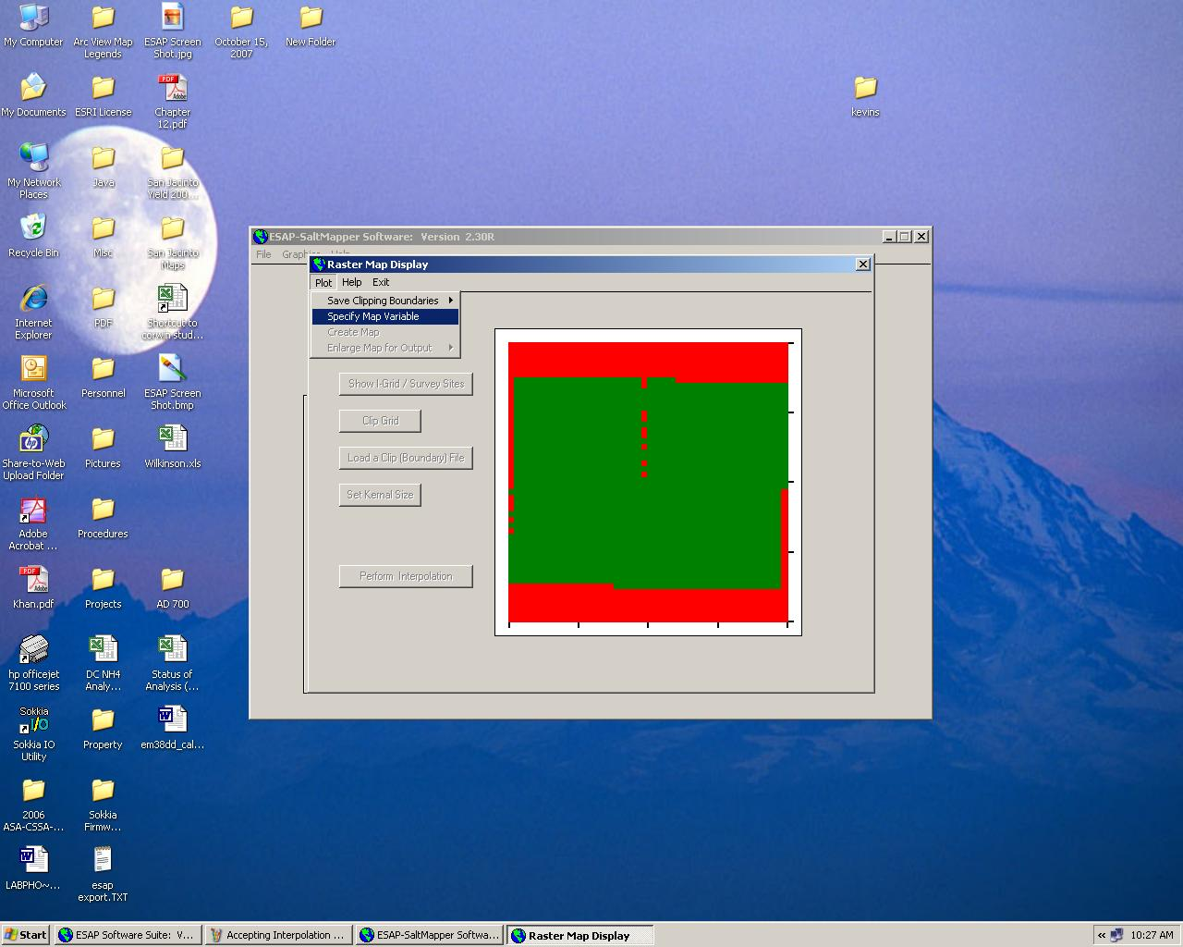
Creating a Salinity Map in ESAP
Select Specify Map Variable from the “Plot” menu.

Slide 46
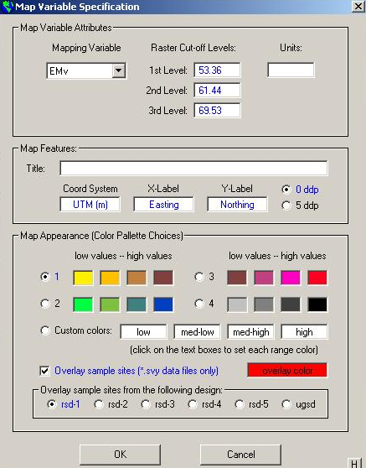
Creating a Salinity Map in ESAP
Customize Variable, Map Features, and Map Appearance. Sample sites may also be overlaid.

Slide 47

Creating a Salinity Map in ESAP
Select Create Map from the “Plot” menu.

Slide 48
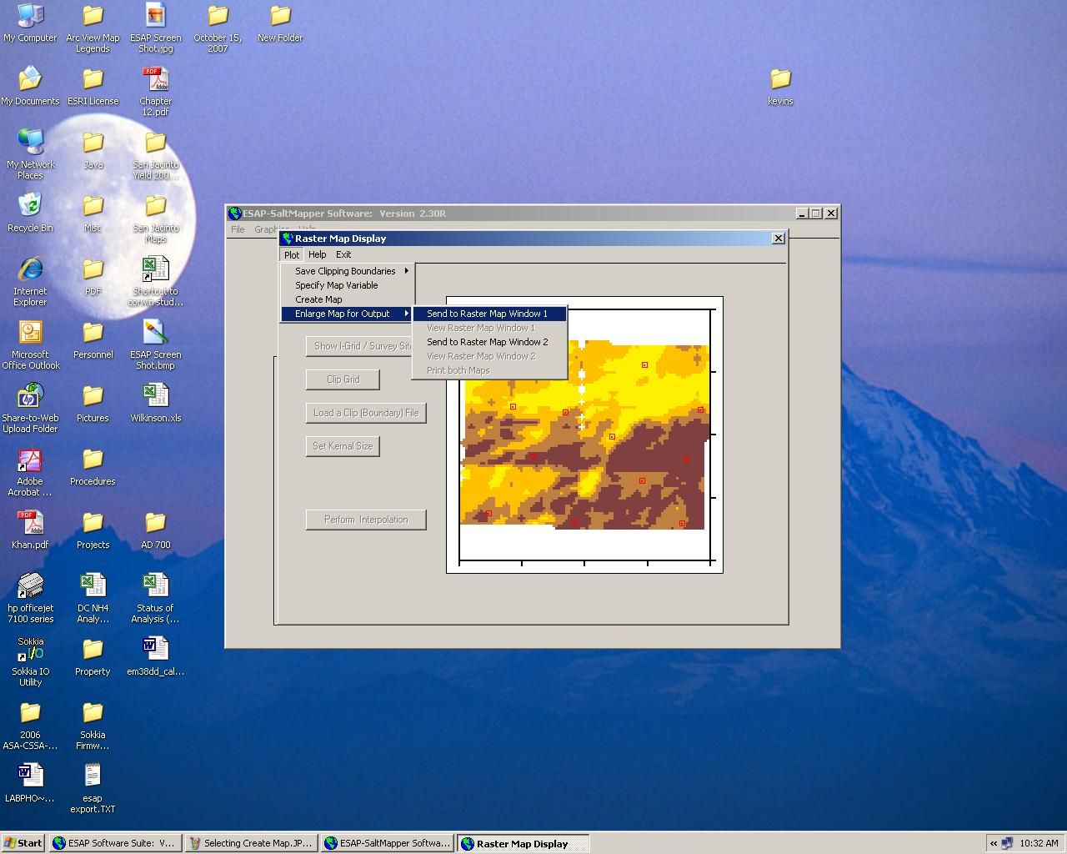
Creating a Salinity Map in ESAP
You can now view your salinity map. Select Enlarge Map for Output from the “Plot” menu to view or print your map.

Slide 49
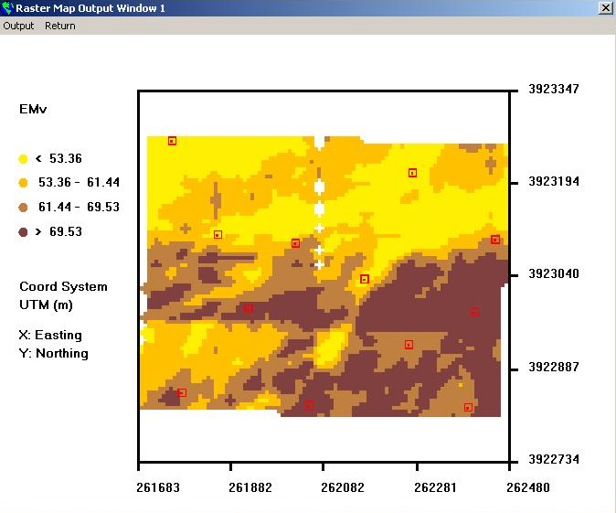
Creating a Salinity Map in ESAP
You can now view and print your enlarged map in the Raster Map Output Window.

Slide 50
Final Note
You can also view a salinity map in the ESAP RSSD program by entering the Interactive Survey Graphics Mode (click on “Graph” and “Open Graphics Window”), selecting Color Scale Grids under the “Graphics” menu, and selecting the desired signal data (s1 is EM_{v}; s2 is EM_{h}).

